Slide 1

Wavelet analysis on Moroccan
& California
Upwelling

Slide 2
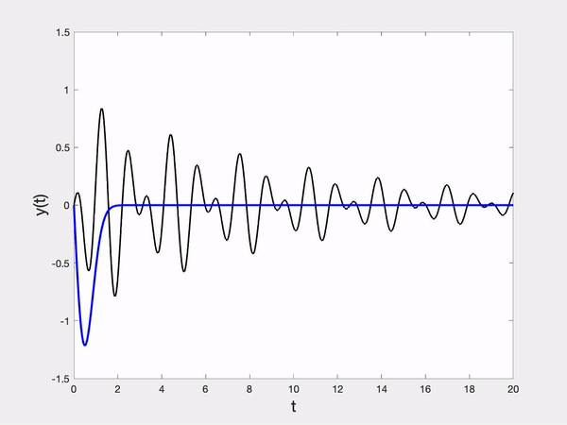
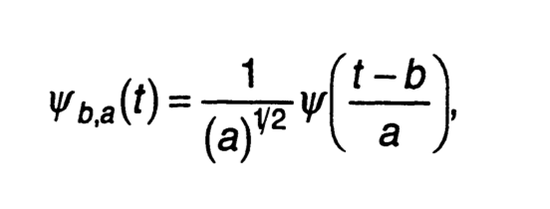
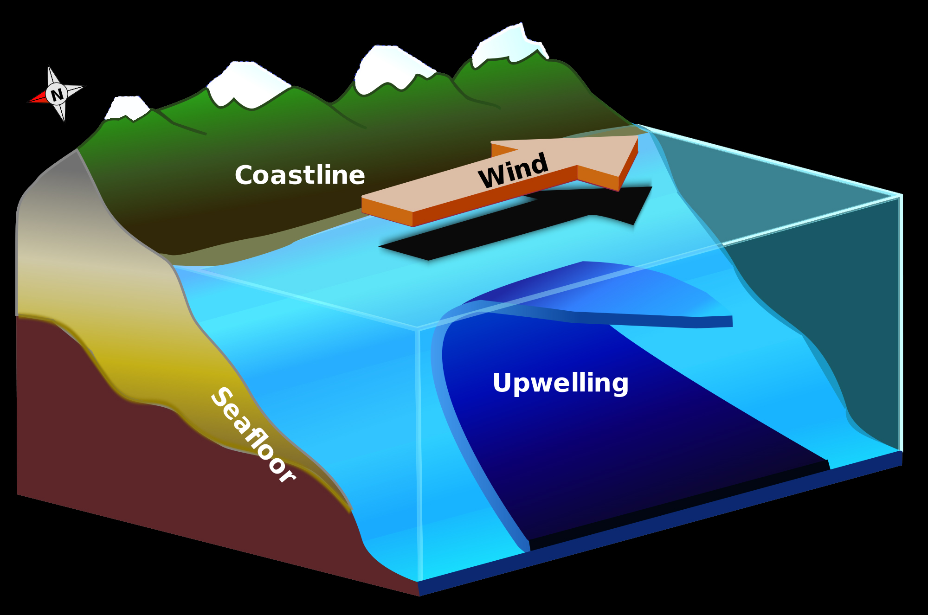
Introduction
Wavelet transform:
Upwelling System

Slide 3
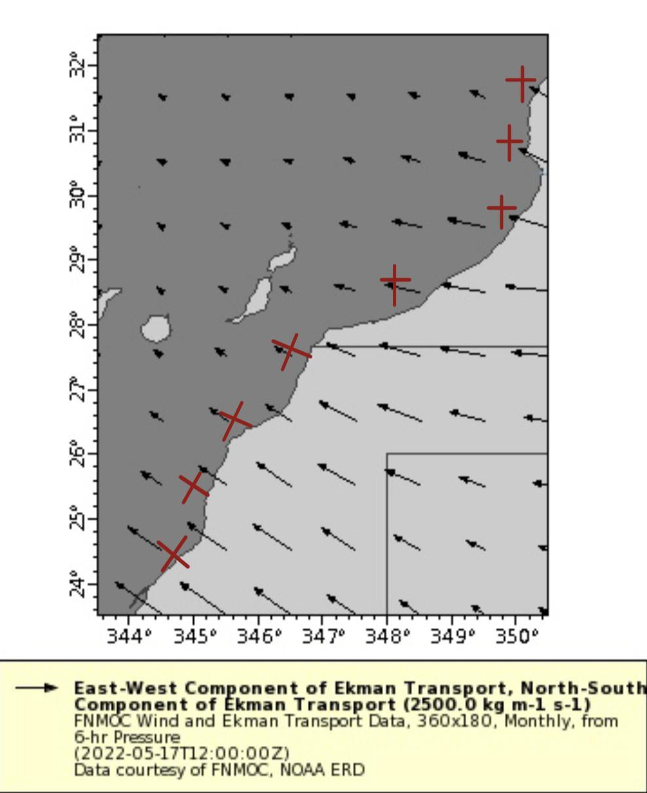
Data
Monthly data from 1982 to 2022 in Moroco.
Daily data from 2017 to 2022 in California
Use wind-driven Ekman Transport as index of upwelling

Slide 4
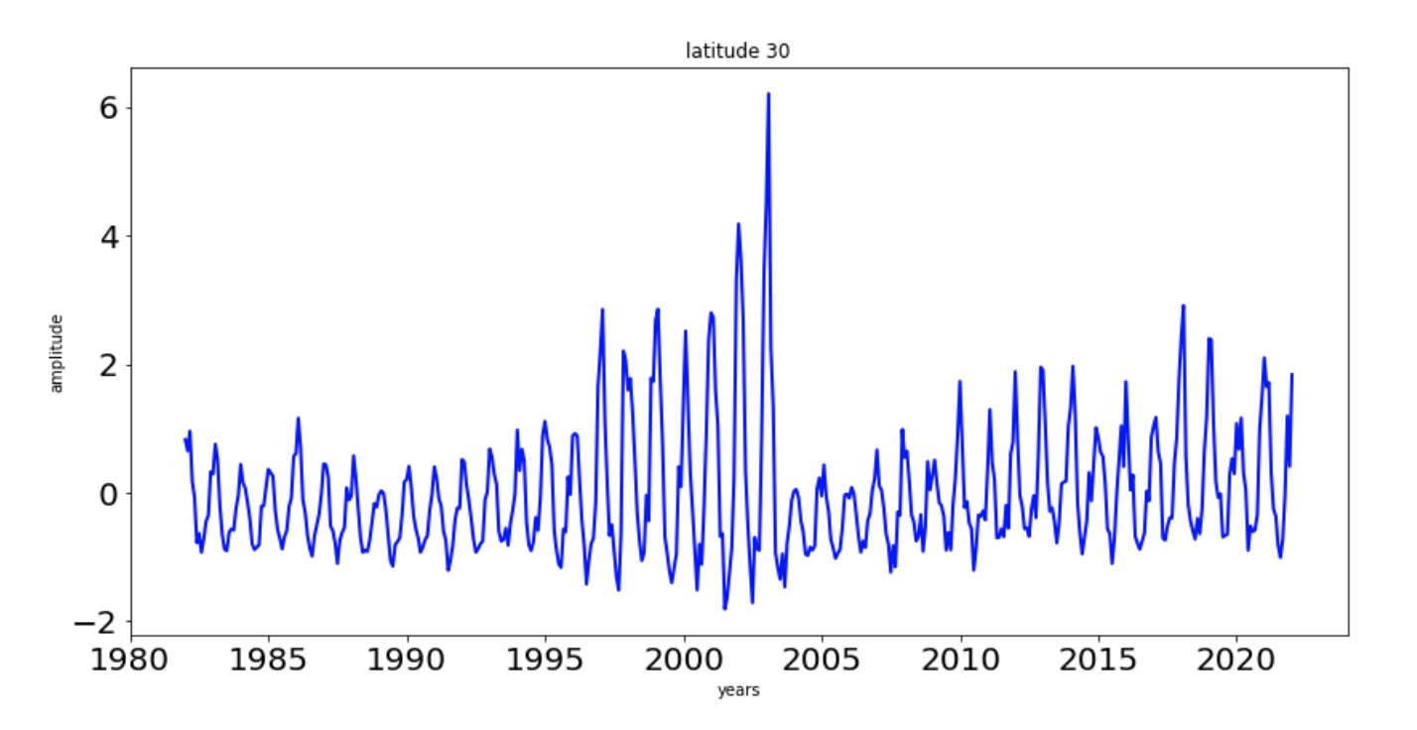
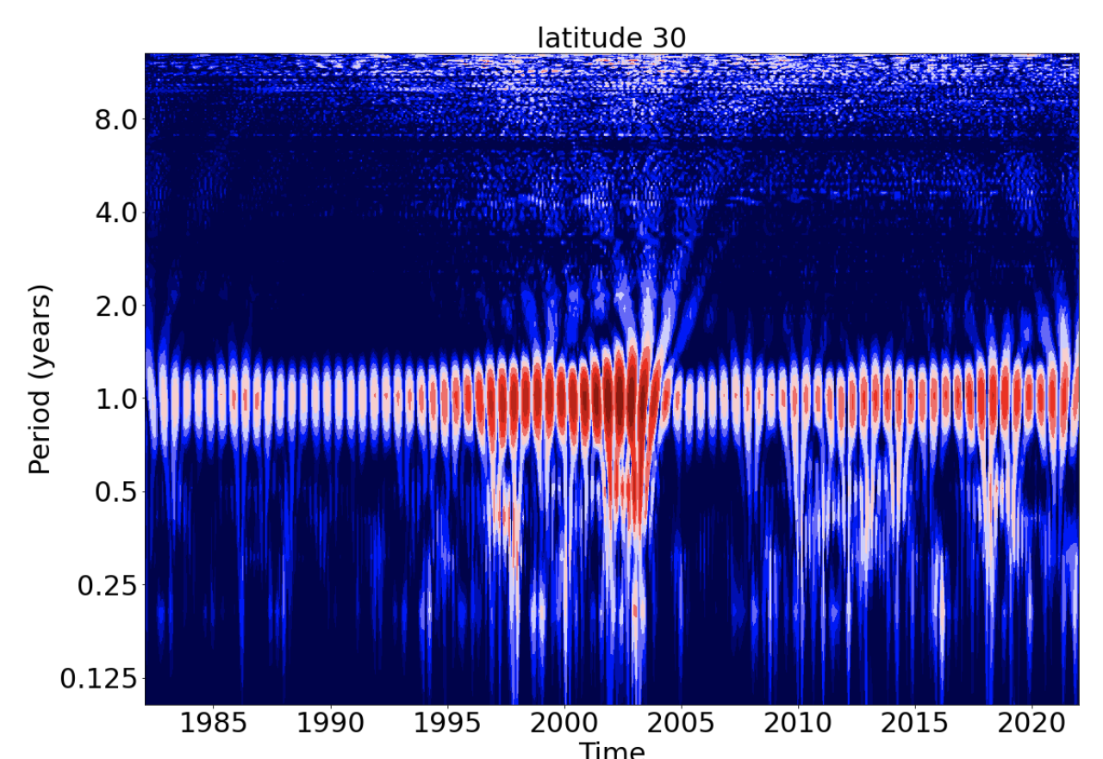
Wavelet analysis on 30 degree north

Slide 5
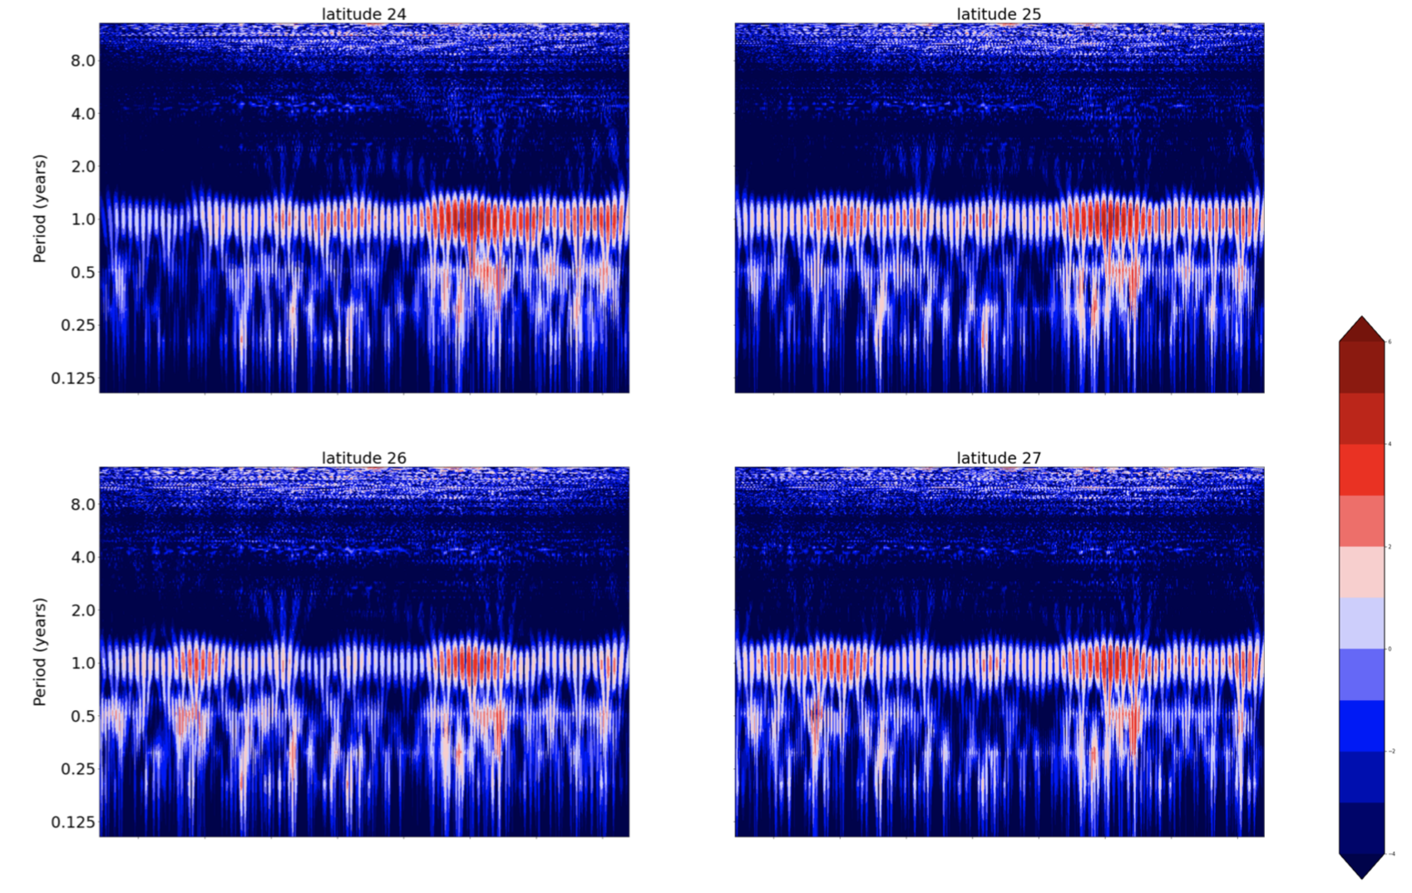
Visualization

Slide 6
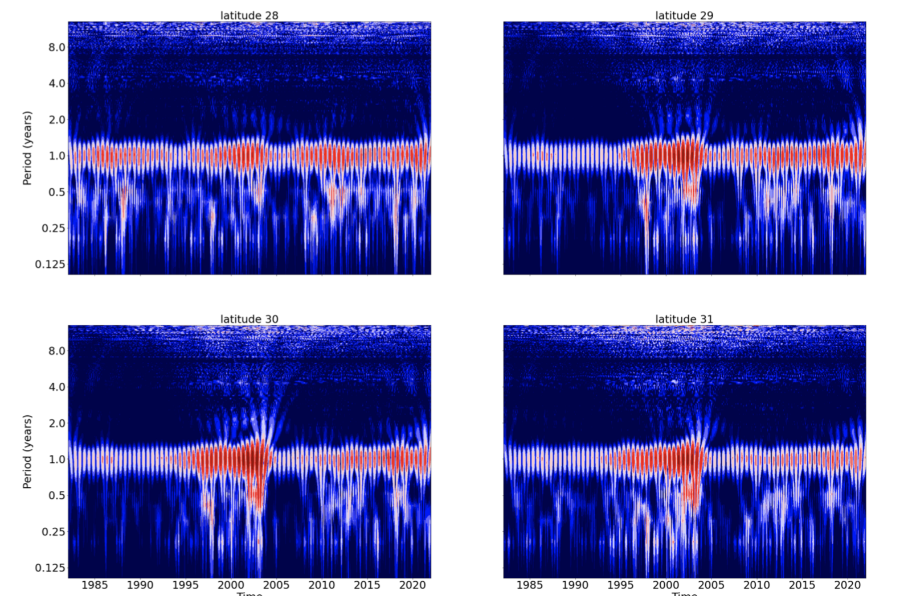
Visualization

Slide 7
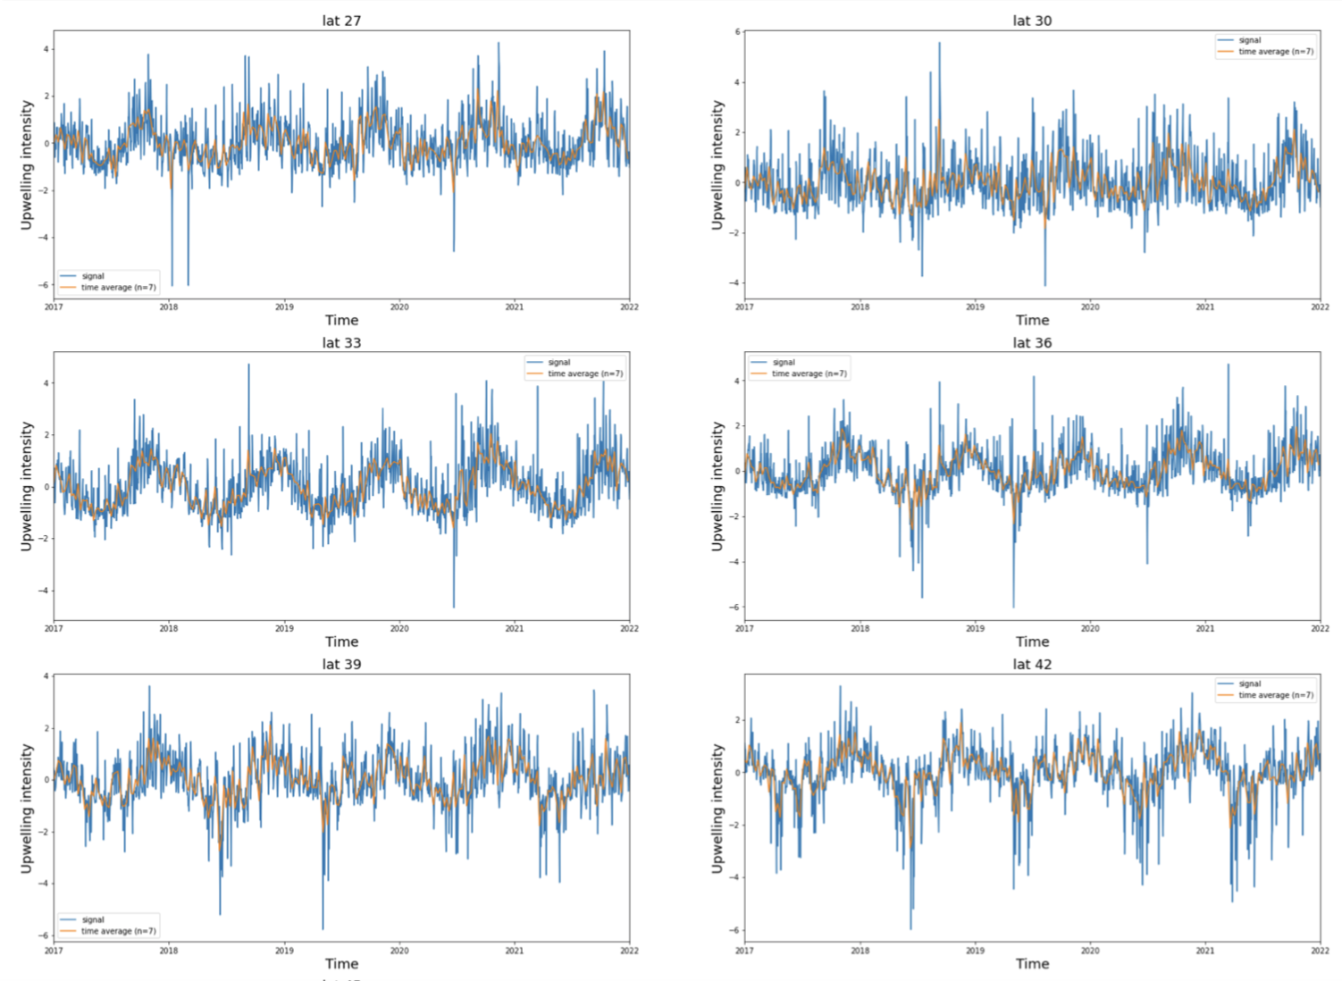
Daily data on California upwelling

Slide 8
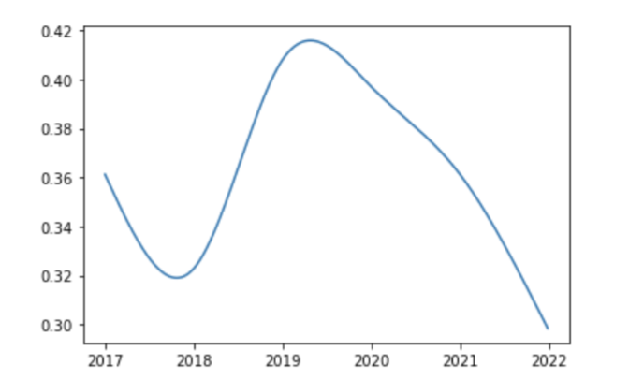
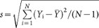
Latitude homogenization
Spatial standard deviation
Where Y_i is value of the upwelling metric at latitude i, Y_hat is spatial mean over all latitude, and N is the number of latitude.
Notes:
Answer: 3

Slide 9
Reference
https://www.jstor.org/stable/pdf/26232616.pdf?refreqid=excelsior%3Ad97225e7d9e9a84e33cd2a7cf69232ac&ab_segments=&origin=&acceptTC=1
https://www.researchgate.net/publication/316648205_Wavelet_analysis_on_upwelling_index_along_the_Moroccan_Atlantic_coast
https://www.nature.com/articles/nature14235
Notes:
Answer: 3

